Slide 1
The PageRank Citation Ranking: Bring Order to the web
Lawrence Page, Sergey Brin, Rajeev Motwani and Terry Winograd
Presented by Fei Li

Slide 2
Motivation and Introduction
Why is Page Importance Rating important?
  New challenges for information retrieval on the World Wide Web.
    Huge number of web pages: 150 million by1998
    1000 billion by 2008
    Diversity of web pages: different topics, different quality, etc.
What is PageRank?
    A method for rating the importance of web pages objectively and mechanically using the link structure of the web.

Slide 3
The History of PageRank
PageRank was developed by Larry Page (hence the name Page-Rank) and Sergey Brin.
It is first as part of a research project about a new kind of search engine. That project started in 1995 and led to a functional prototype in 1998.
Shortly after, Page and Brin founded Google.
16 billion…
Notes:
The name PageRank is a trademark of Google. The PageRank process has been patented (U.S. Patent 6,285,999). The patent is assigned to Stanford University and not to Google. Google has exclusive license rights on the patent from Stanford University. The university received 1.8M shares in exchange for the patent. The shares were sold in 2005 for $336M. (from wiki)

Slide 4
Recent News
There are some news about that PageRank will be canceled by Google.
There are large numbers of Search Engine Optimization (SEO).
SEO use different trick methods to make a web page more important under the rating of PageRank.
Notes:
The name PageRank is a trademark of Google. The PageRank process has been patented (U.S. Patent 6,285,999). The patent is assigned to Stanford University and not to Google. Google has exclusive license rights on the patent from Stanford University. The university received 1.8M shares in exchange for the patent. The shares were sold in 2005 for $336M. (from wiki)

Slide 5
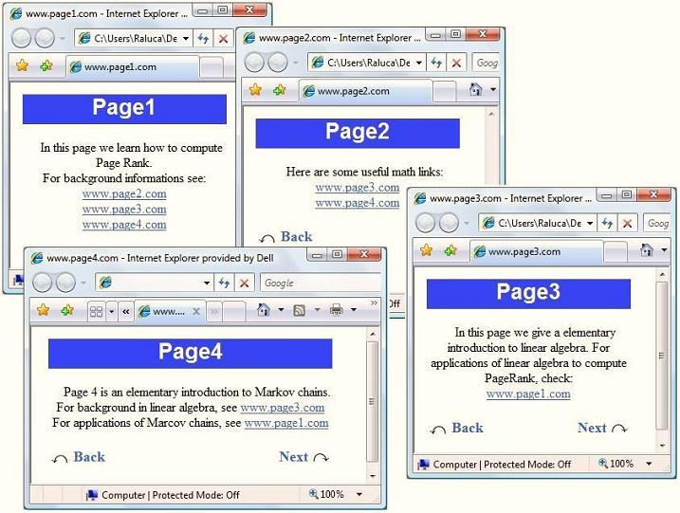


Slide 6
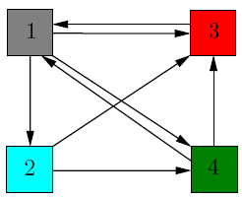
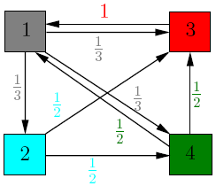

Slide 7
Background
Scenario:
  A random surfer who begins at a Web page A.
  Execute a random walk from A to a randomly chosen Web page that A hyperlinks to.
  Some nodes are visited more often. Intuitively, these are nodes with many links coming in from other frequently visited nodes.
Idea:
  Pages visited more often in this walk are more important.
B
A
C
D

Slide 8
Background
Problem:
  Current location of the surfer, e.g., node A, has no out-links?
  Teleport operation:
    The surfer jumps from a node to any other node in the Web graph.
    E.g.: Type an address into the URL bar.
    The destination of a teleport operation is chosen uniformly at random from all Web pages: 1/N
PageRank Scheme:
  At node with no output-links: teleport operation
  At node with output-links: teleport operation with probability 0<α<1 and the standard random walk 1- α. α is a fixed parameter chosen in advance.

Slide 9

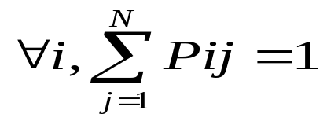
Markov Chains
Markov Chain:
  A Markov chain is a discrete-time stochastic process consisting of N states, each Web page corresponds to a state.
  A Markov chain is characterized by an N*N transition probability matrix P.
Transition Probability Matrix:
  Each entry is in the interval [0,1].
  P_{ij} is the probability that the state at the next time-step is j, conditioned on the current state being i.
  Each entry P_{ij} is known as a transition probabilit and depends only on the current state i. Markov property.

Slide 10
Markov Chains
Transition Probability Matrix:
  A matrix with non-negative entries that satisfies
  is known as a stochastic matrix.
  Has a principal left eigenvector corresponding to its largest eigenvalue, which is 1.
Derive the Transition Probability Matrix P:
  Build the adjacency matrix A of the web graph.
    There is a hyperlink from page i to page j, Aij = 1, otherwise Aij =0.
  Derive each 1 in A by the number of 1s in its row.
  Multiply the resulting matrix by 1- α.
  Add α/N to every entry of the resulting matrix, to obtain P.

Slide 11
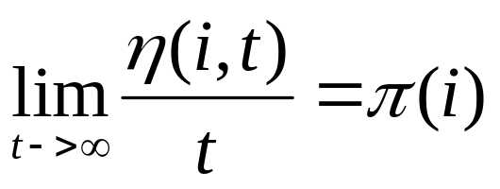
Markov Chains
Ergodic Markov Chain :
  Conditions:
    Irreducibility
      A sequence of transitions of nonzero probability from any state to any state.
    Aperiodicity
      States are not partitioned into sets such that all state transitions occur cyclically from one set to another.
  Property:
    There is a unique steady-state probability vector π that is the principal left eigenvector of P.
    η(i,t) is the number of visits to state i in t steps.
    π(i)>0 is the steady-state probability for state i.

Slide 12
PageRank Computation
Target
  Solve the steady-state probability vector π, which is the PageRank of the corresponding Web page.
  πP=λ π, λ is 1 for stochastic matrix.
Method
  Power iteration.
  Given an initial probability distribution vector x0
  x0*P=x1, x1*P=x2 … Until the probability distribution converges. (Variation in the computed values are below some predetermined threshold.)

Slide 13
Exercise on PageRank
Consider a Web graph with three nodes 1, 2, and 3. The links are as follows: 1->2, 3->2, 2->1, 2->3. Write down the transition probability matrices P for the surfer’s walk with teleporting, with the value of teleport probability α=0.5.
0 | 1 | 0
1 | 0 | 1
0 | 1 | 0
2
A=
Each 1 divied by the number of ones in this row
1
0 | 1 | 0
½ | 0 | ½
0 | 1 | 0
(1- α)*
3
+
1/3 | 1/3 | 1/3
1/3 | 1/3 | 1/3
1/3 | 1/3 | 1/3
1/6 | 2/3 | 1/6
5/12 | 1/6 | 5/12
1/6 | 2/3 | 1/6
α*
=

Slide 14
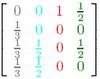
Let us denote by A the transition matrix of the graph, A =

Slide 15
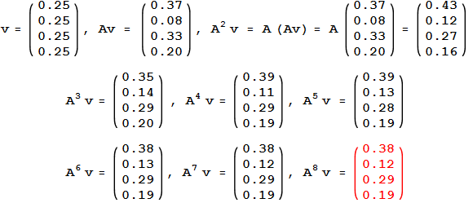
Denote by v the initial rank vector, having all entries equal to ¼. Each incoming link increases the importance of a web page, so at step 1, we update the rank of each page by adding to the current value the importance of the incoming links.
This is the same as multiplying the matrix A with v .
At step 1, the new importance vector is v₁ = Av.
We can iterate the process, thus at step 2, the updated importance vector is v₂ = A(Av) = A²v

Slide 16
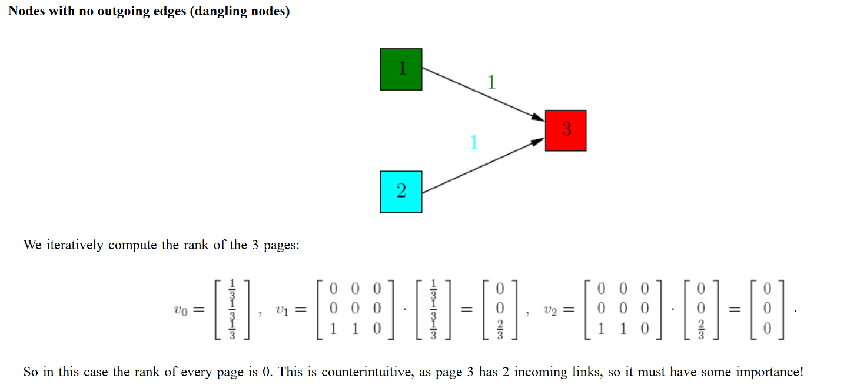
An easy fix for this problem would be to replace the column corresponding to the dangling node 3 with a column vector with all entries 1/3. In this way, the importance of node 3 would be equally redistributed among the other nodes of the graph, instead of being lost.

Slide 17
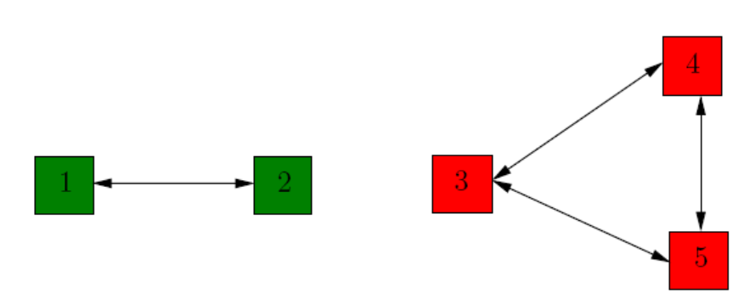
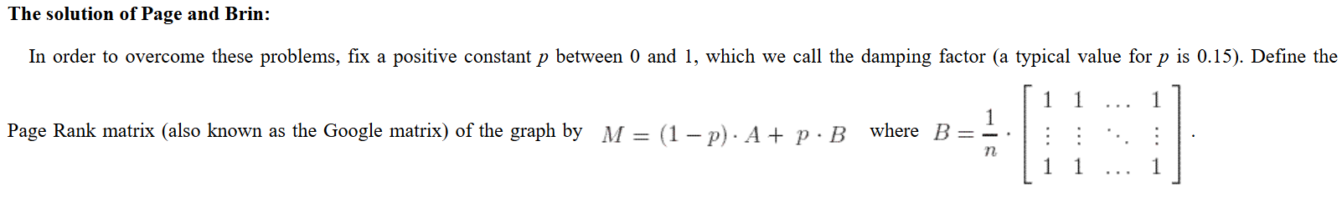
Disconnected Components

Slide 19
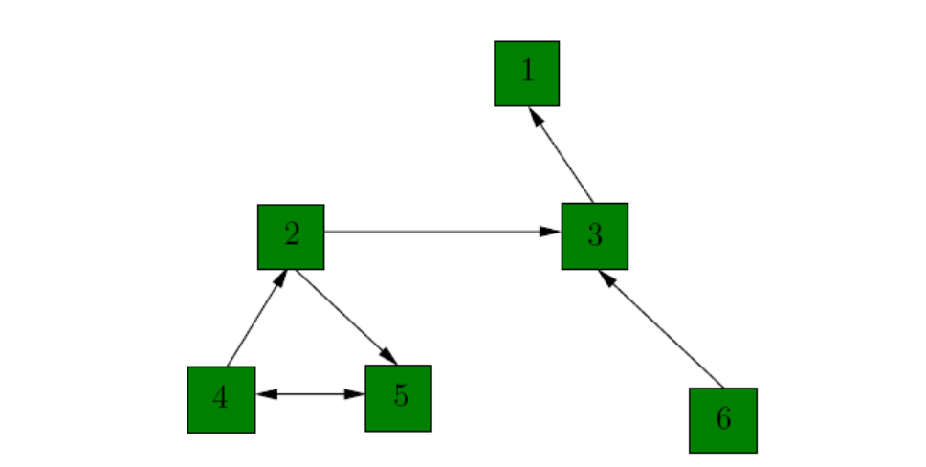
Exercise 1
Compute the PageRank vector of the following graph, considering the damping constant p to be successively p = 0, p = 0.15, p = 0.5, and respectively p = 1.

Slide 20
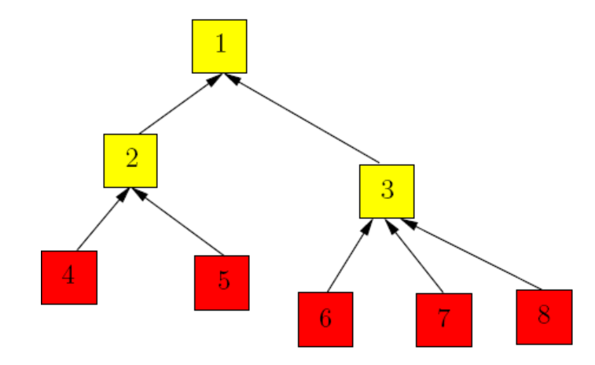
Exercise 2
Compute the PageRank vector of the directed tree depicted below, considering that the damping constant p = 0.15. Interpret your results in terms of the relationship between the number of incoming links that each node has and its rank.

Slide 21
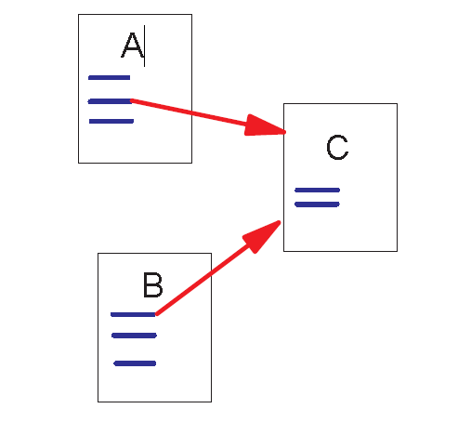
Link Structure of the Web
150 million web pages → 1.7 billion links
Backlinks and Forward links:
A and B are C’s backlinks
C is A and B’s forward link
Intuitively, a webpage is important if it has a lot of backlinks.
What if a webpage has only one link off www.yahoo.com?

Slide 22
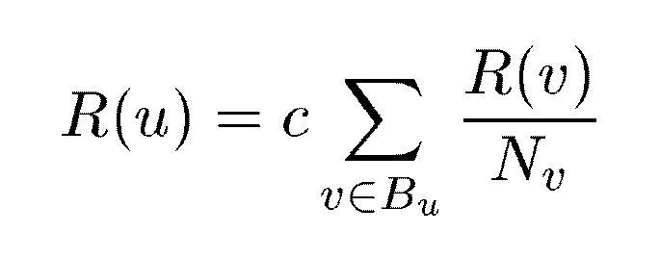
A Simple Version of PageRank
u: a web page
B_{u}: the set of u’s backlinks
N_{v}: the number of forward links of page v
c: the normalization factor to make ||R||_{L1} = 1 (||R||_{L1}= |R₁ + … + R_{n}|)

Slide 23
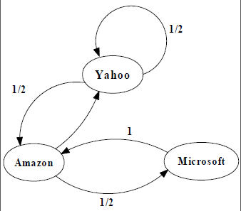
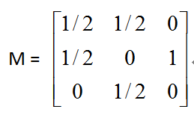
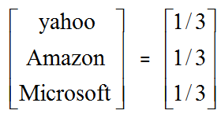
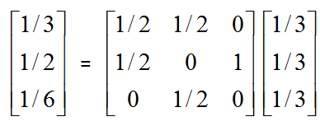
An example of Simplified PageRank
PageRank Calculation: first iteration

Slide 24
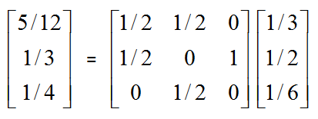
An example of Simplified PageRank
PageRank Calculation: second iteration

Slide 25
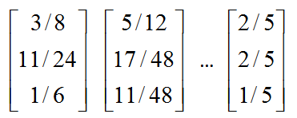
An example of Simplified PageRank
Convergence after some iterations

Slide 26
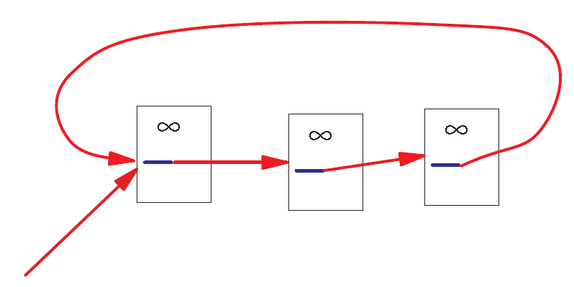
A Problem with Simplified PageRank
A loop:
During each iteration, the loop accumulates rank but never distributes rank to other pages!

Slide 27
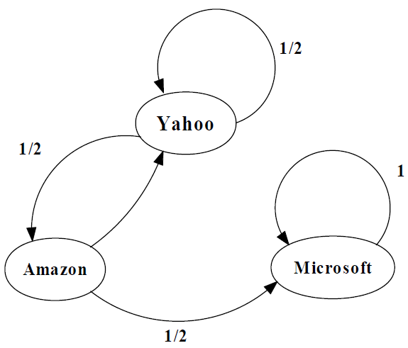
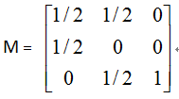
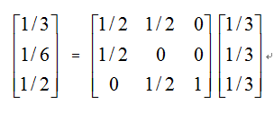
An example of the Problem

Slide 28
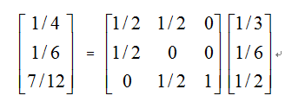
An example of the Problem

Slide 29
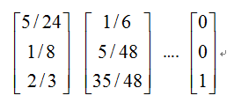
An example of the Problem

Slide 30
Random Walks in Graphs
The Random Surfer Model
  The simplified model: the standing probability distribution of a random walk on the graph of the web. simply keeps clicking successive links at random
The Modified Model
  The modified model: the “random surfer” simply keeps clicking successive links at random, but periodically “gets bored” and jumps to a random page based on the distribution of E

Slide 31
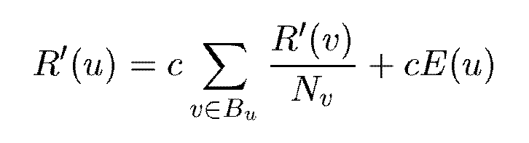


Modified Version of PageRank
E(u): a distribution of ranks of web pages that “users” jump to
when they “gets bored” after successive links at random.

Slide 32

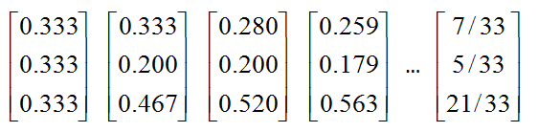
An example of Modified PageRank

Slide 33
Dangling Links
Links that point to any page with no outgoing links
Most are pages that have not been downloaded yet
Affect the model since it is not clear where their weight should be distributed
Do not affect the ranking of any other page directly
Can be simply removed before pagerank calculation and added back afterwards

Slide 34
PageRank Implementation
Convert each URL into a unique integer and store each hyperlink in a database using the integer IDs to identify pages
Sort the link structure by ID
Remove all the dangling links from the database
Make an initial assignment of ranks and start iteration
    Choosing a good initial assignment can speed up the pagerank
Adding the dangling links back.

Slide 35
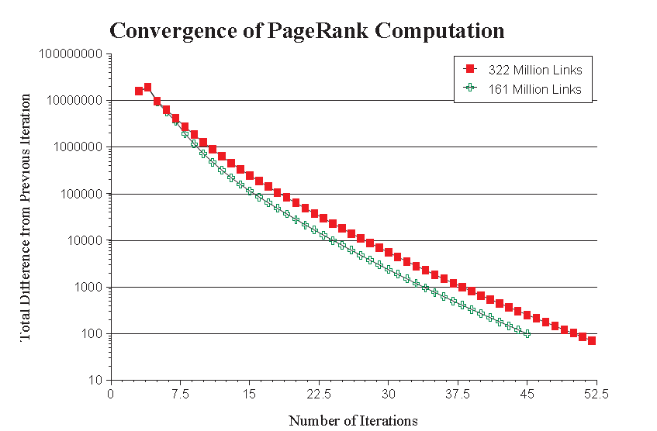
Convergence Property
PR (322 Million Links): 52 iterations
PR (161 Million Links): 45 iterations
Scaling factor is roughly linear in logn

Slide 36
Convergence Property
The Web is an expander-like graph
  Theory of random walk: a random walk on a graph is said to be rapidly-mixing if it quickly converges to a limiting distribution on the set of nodes in the graph. A random walk is rapidly-mixing on a graph if and only if the graph is an expander graph.
  Expander graph: every subset of nodes S has a neighborhood (set of vertices accessible via outedges emanating from nodes in S) that is larger than some factor α times of |S|. A graph has a good expansion factor if and only if the largest eigenvalue is sufficiently larger than the second-largest eigenvalue.

Slide 37
Searching with PageRank
Two search engines:
  Title-based search engine
  Full text search engine
Title-based search engine
  Searches only the “Titles”
  Finds all the web pages whose titles contain all the query words
  Sorts the results by PageRank
  Very simple and cheap to implement
  Title match ensures high precision, and PageRank ensures high quality
Full text search engine
  Called Google
  Examines all the words in every stored document and also performs PageRank (Rank Merging)
  More precise but more complicated

Slide 38
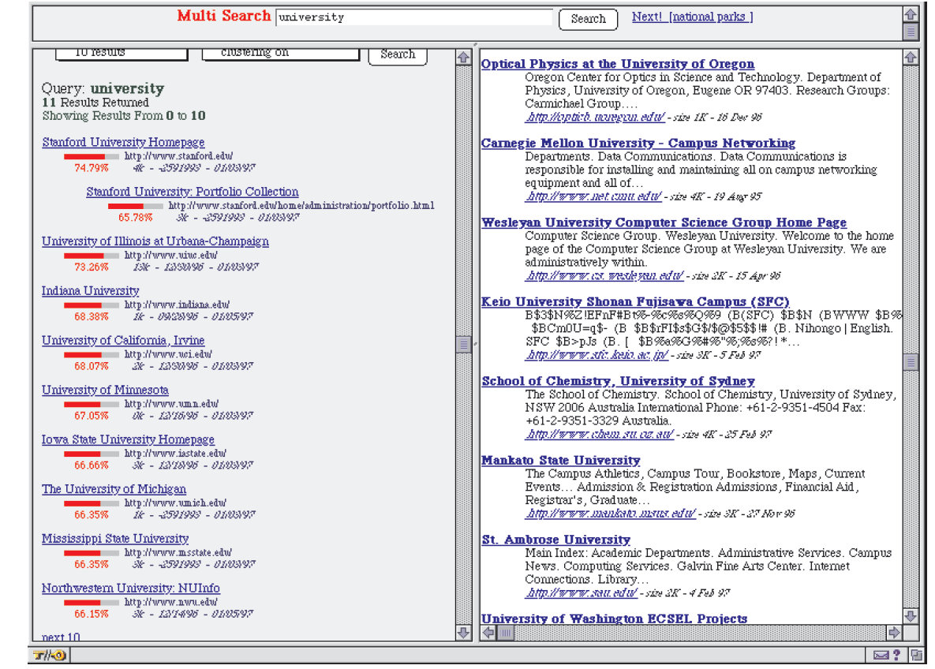
Searching with PageRank

Slide 39
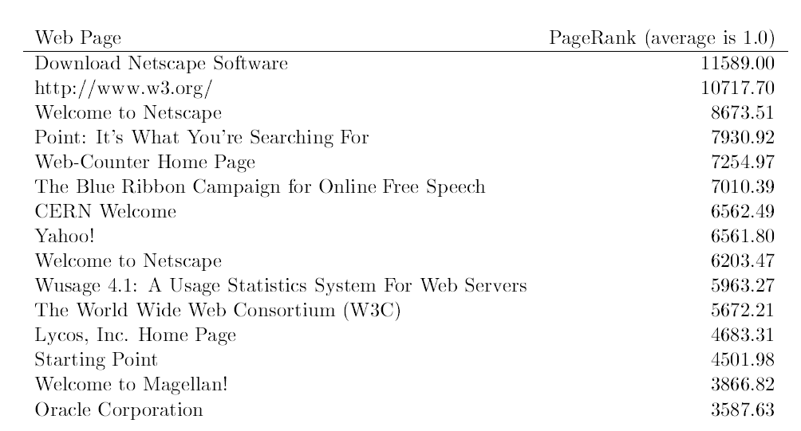

Searching with PageRank

Slide 40
Personalized PageRank
Important component of PageRank calculation is E
  A vector over the web pages (used as source of rank)
  Powerful parameter to adjust the page ranks
E vector corresponds to the distribution of web pages that a random surfer periodically jumps to
Instead in Personalized PageRank E consists of a single web page

Slide 41
PageRank vs. Web Traffic
Some highly accessed web pages have low page rank possibly because
  People do not want to link to these pages from their own web pages (the example in their paper is pornographic sites…)
  Some important backlinks are omitted
  use usage data as a start vector for PageRank.

Slide 42
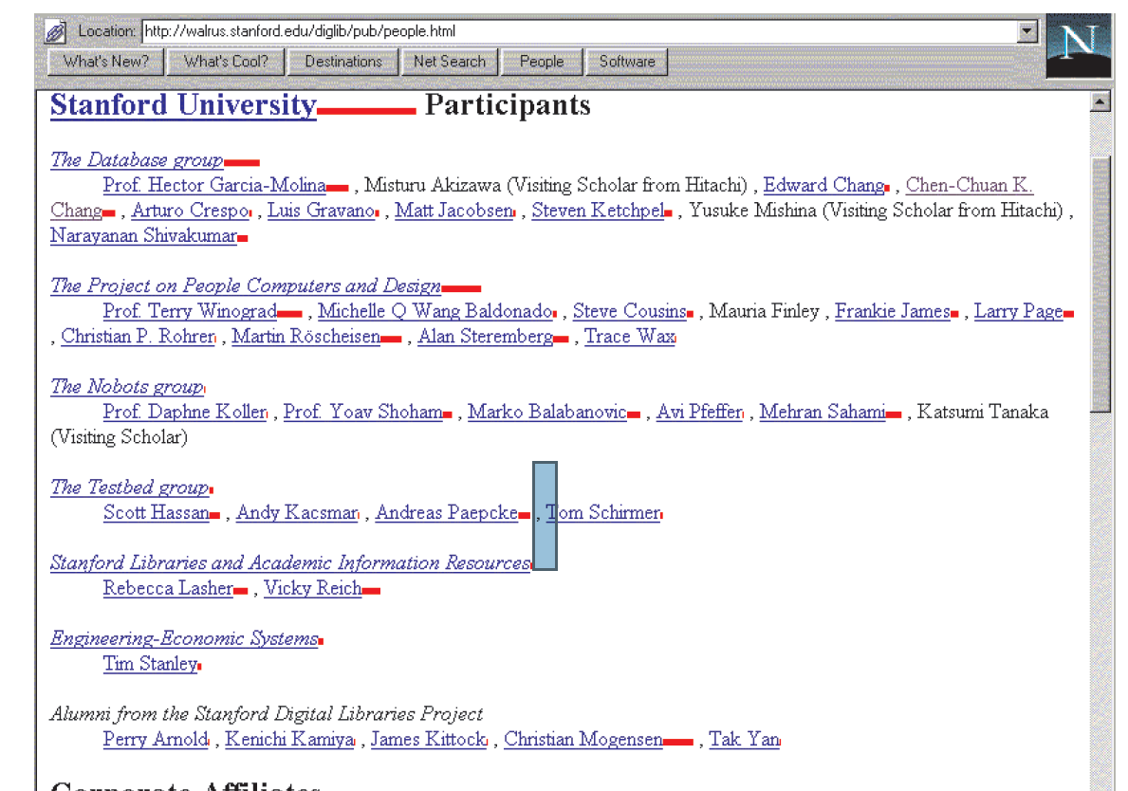
The PageRank Proxy

Slide 43
Conclusion
PageRank is a global ranking of all web pages based on their locations in the web graph structure
PageRank uses information which is external to the web pages – backlinks
Backlinks from important pages are more significant than backlinks from average pages
The structure of the web graph is very useful for information retrieval tasks.

